Slide 1
Predictive Analytics and fraud detection in insurance claims
Data Visualization
Final Project : Data Visualization Using Python
Part-Time
2024
Developers Institute of Mauritius

Slide 2
Outline
Introduction
Aims
Dataset Description
Dependent variable and Independent variable
Data preprocessing
Encoding categorical columns
Outliers Detection
Machine Learning – Models

Slide 3
Introduction
The project focuses on analyzing an insurance claims dataset to uncover insights related to claim patterns, fraud detection, customer demographics, and other key trends. Understanding these patterns can help insurance companies streamline operations, reduce fraud, and improve customer satisfaction.
Aim
Identify trends and anomalies in insurance claims.
Explore relationships between customer demographics and claim outcomes.
Detect patterns indicative of fraudulent claims.
Provide actionable insights for decision-making.

Slide 4
Dataset Description
The dataset contains information about various insurance claims, including:
Customer details (age, gender, etc.).
Policy details (policy number, coverage).
Claim details (amount claimed, fraud detection indicators).
Incident details (type, severity, location).

Slide 5
Dependent variable and Independent variable
In this dataset, the dependent variable (also known as the target variable) is likely fraud reported, which indicates whether an insurance claim is classified as fraudulent ("Y") or not ("N").
The independent variables (or features) are the remaining columns, which provide information that can be used to predict the target.

Slide 6
Breakdown of the potential independent variables: Categorical Columns (Potential Features):
insured_sex: Gender of the insured.
insured_education_level: Educational level of the insured.
insured_occupation: Occupation of the insured.
incident_type: Type of the incident.
collision_type: Type of collision, if applicable.
incident_severity: Severity of the incident.
authorities_contacted: Which authorities were contacted (e.g., police, fire department).

Slide 7
Numerical Columns (Potential Features):
age: Age of the insured.
incident_hour_of_the_day: The hour when the incident occurred.
injury claim: Amount claimed for injuries.
property claim: Amount claimed for property damage.
vehicle claim: Amount claimed for vehicle damage

Slide 8
Data pre processing and Handling Missing Values :
Remove Blank Columns: Drop the '_c39' column as it is completely blank.
Replace and Fill Missing Values: Replace all instances of the string '?' with NaN across the entire dataset, and fill missing values (NaN) in the specified columns with 0.
Drop Unnecessary Columns: Remove the following columns from the dataset as they are considered unnecessary: 'policy_number', 'policy_deductible', 'policy_state', 'insured_zip', 'incident_location', 'incident_date', 'incident_state', 'incident_city', 'insured_hobbies', 'auto_make', 'auto_model', 'auto_year', 'policy_annual_premium', 'umbrella_limit', 'capital-gains', 'capital-loss', 'property_damage', 'bodily_injuries', 'witnesses', 'insured_relationship', 'policy_csl', 'months_as_customer', 'total_claim_amount', 'number_of_vehicles_involved', 'police_report_available'.
Drop Redundant Columns: Exclude the 'total_claims' column as it is a sum of the 'injury_claims', 'property_claims', and 'vehicle_claims'.

Slide 9
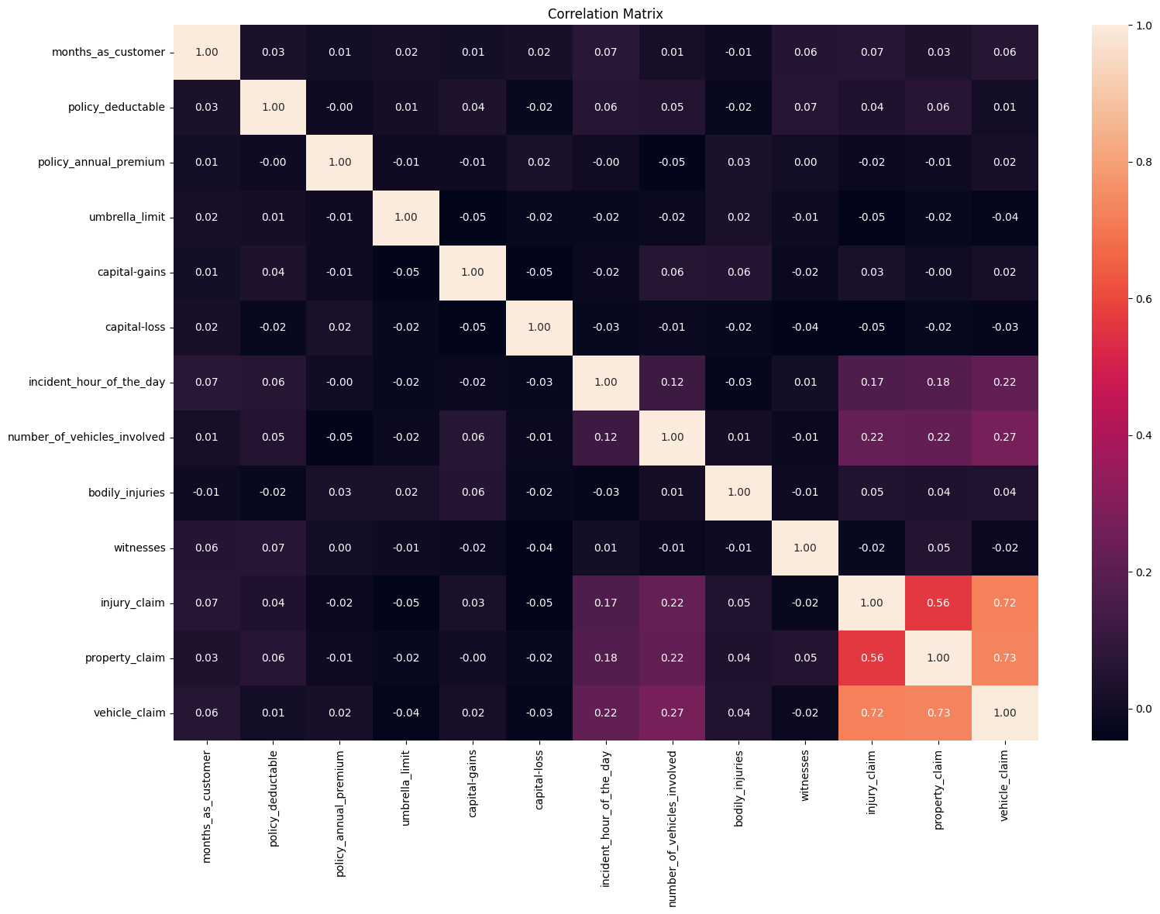
Correlation Matrix

Slide 10
correlation matrix heatmap
Strong Correlations:
There seems to be a strong positive correlation :
Between Age (around 0.92), vehicle_claim and injury claim (around 0.72).property_claim (close to 0.73)
Exclude the 'total_claims' column as it is a sum of the 'injury_claims', 'property_claims', and 'vehicle_claims
Weak or No Correlations:
Most other variables appear to have weak or no significant correlation (values close to 0).

Slide 11
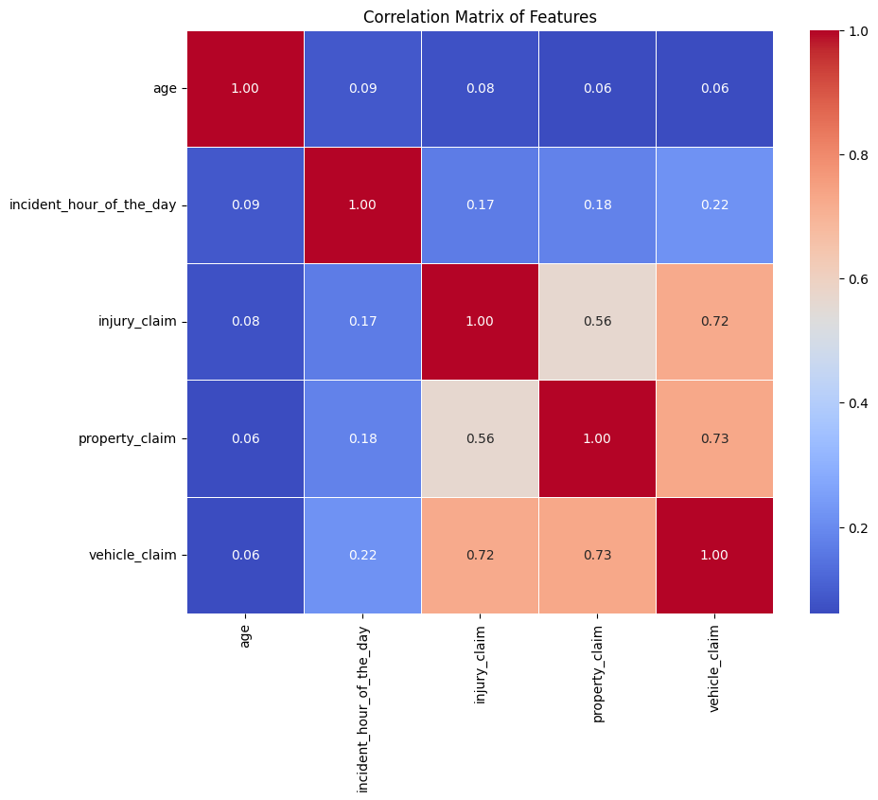
Correlation Matrix after handling the Missing values

Slide 12
VIF (Variance Inflation Factor)
Variance Inflation Factor (VIF): The VIF function is used to measure collinearity between the features in a regression model.
Interpreting VIF:
VIF = 1: No multicollinearity.
1 < VIF < 5: Moderate multicollinearity.
VIF > 5: High multicollinearity, consider removing the feature.
The VIF values for all the features (age, incident_hour_of_the_day, injury claim, property claim, vehicle claim) are well below 5, which indicates that there is no severe multicollinearity between these features.
All VIF values are close to 1 or in the range of 1.0 to 3.13, which is indicative of low to moderate correlation among the features.
The dataset has low multicollinearity, which is a positive outcome, as it means the features in your model should be able to contribute independently to explaining the target variable (such as fraud detection).
There is no need to remove any features based on the VIF results

Slide 13
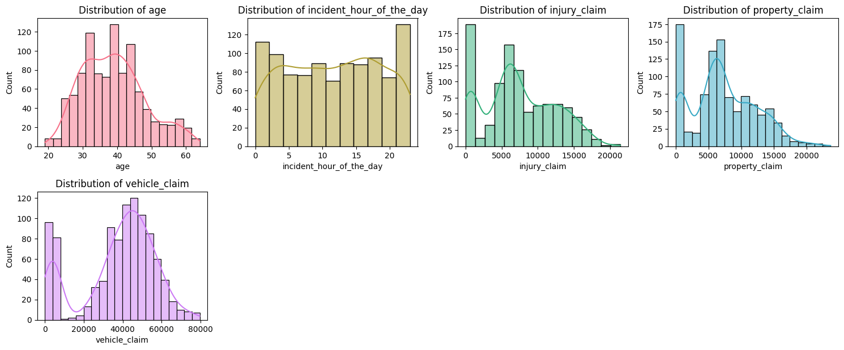
Distribution in numerical feature

Slide 14
Distribution
The claim distributions (injury, property, vehicle) are likely fine if they are right-skewed, as this is typical for claims data.
The incident hour distribution should show patterns of when incidents are more likely to happen, and a peaked distribution could be expected.
The age distribution should reflect the actual demographic distribution eg ; different age group, gender income and others , and whether it's "good" depends on your target population.
we need to remove the outliers , right-skewed in (injury, property, vehicle)
and normalized the data

Slide 15
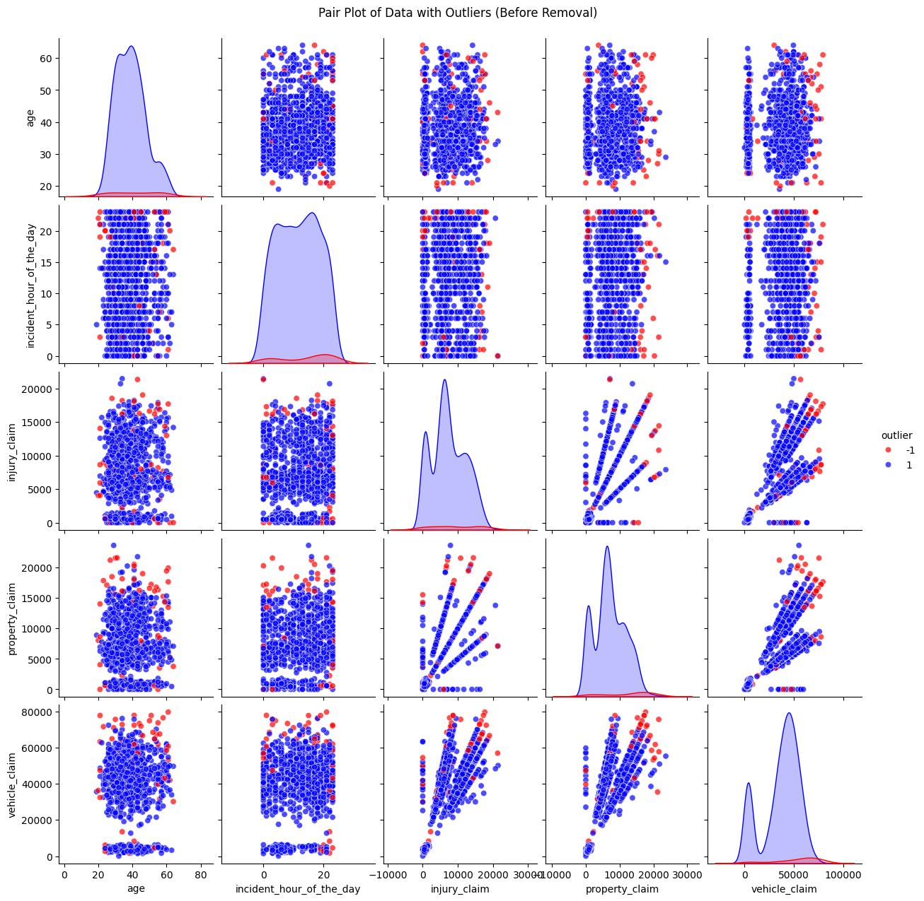
Initialize Isolation Forest (outliers)

Slide 16
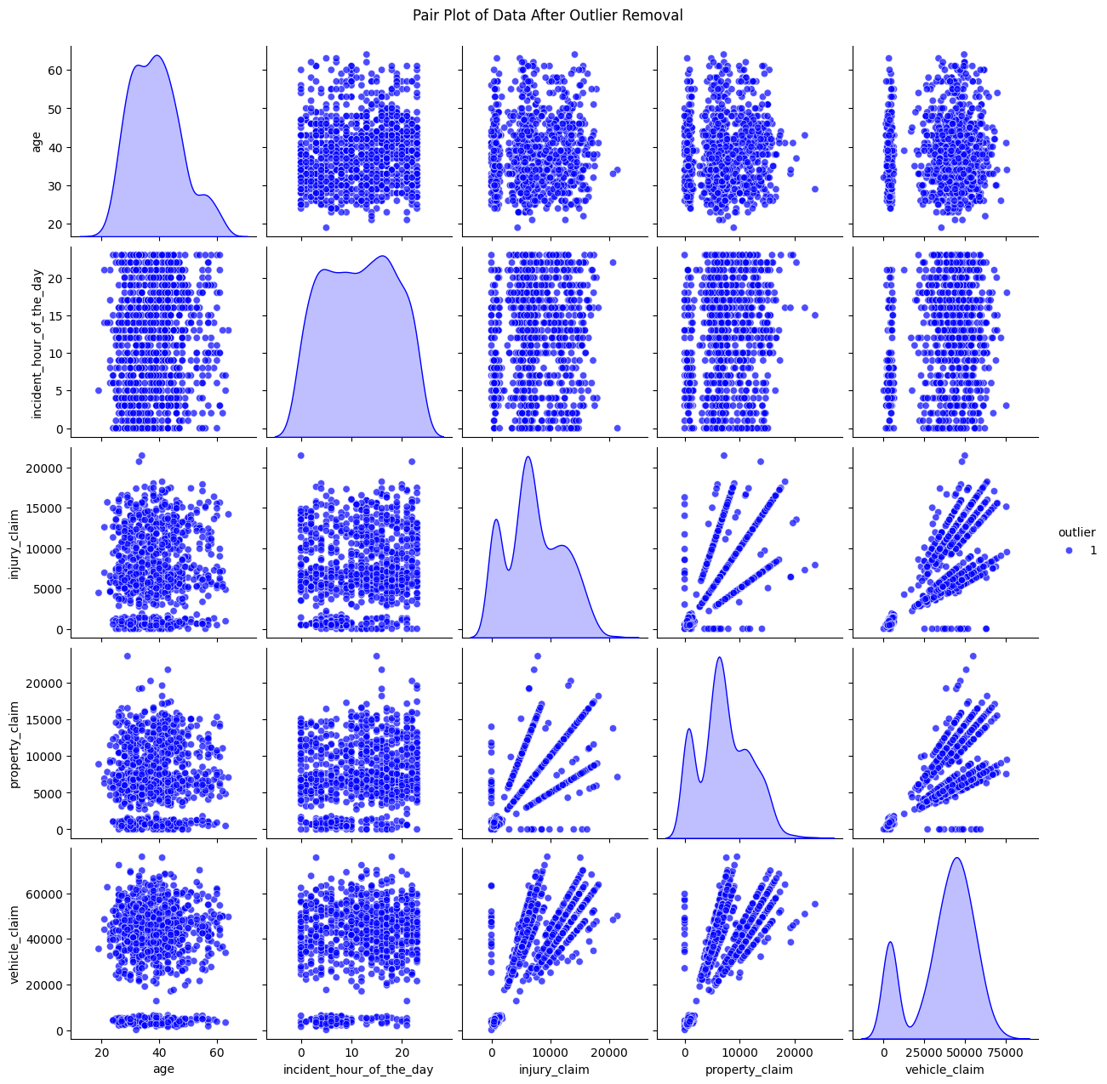
Pair plot data after outlier removal

Slide 17
Splitting data into training and test set
Train-Test Split: The data is split into training and testing sets (80-20 split) using X_resampled and y_resampled, which suggests the data may have been balanced beforehand.
Model Definitions: A dictionary of models is created, with each key representing the model name and each value representing the corresponding model instance.
The model is trained on the training data. Training and test accuracy are calculated using accuracy_score.A classification report (precision, recall, F1-score) and a confusion matrix are printed to provide detailed evaluation metrics.
Models use for the evaluation: RandomForestClassifier,Logistic Regression-Nearest Neighbors, Support Vector Machine, Gradient Boosting,Extra Trees and XGBoost

Slide 18
Models Performance
 | Model | Test Accuracy | Train Accuracy
5 | Extra Trees | 0.9073 | 1.0000
0 | Random Forest | 0.8841 | 1.0000
3 | Support Vector Machine | 0.8576 | 0.9684
6 | XGBoost | 0.8477 | 1.0000
4 | Gradient Boosting | 0.8377 | 0.9510
2 | K-Nearest Neighbors | 0.8344 | 0.8962
1 | Logistic Regression | 0.8311 | 0.8721

Slide 19
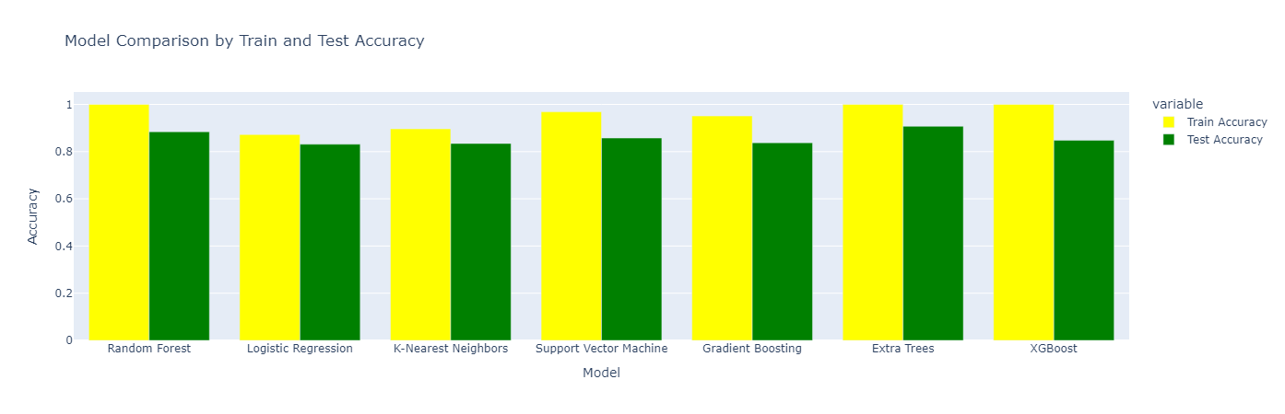
Model comparison by using Train and Test Accuracy

Slide 20
Best Model Extra tree
Extra Trees delivers the highest test accuracy among all models at 90.73%
With higher test accuracy means the model is better at making predictions on new, unseen instances.
. Extra Trees typically have fewer hyper parameters that need careful tuning compared to models like XGBoost or Gradient Boosting. This means it simpler to work with while still providing strong performance
Extra Trees is the best model in your case because it delivers the highest test accuracy, avoids over fitting, and provides a solid balance between performance and simplicity. Its ability to generalize well, combined with its robustness to hyper parameters and decent interpretability, makes it a reliable choice for this classification task.

Slide 21
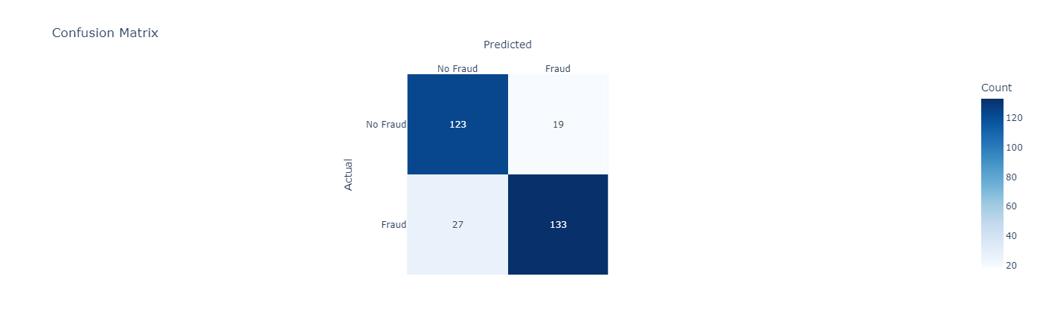
Confusion Matrix to Predict No fraud and fraud

Slide 22
Model prediction for extra tree
High Accuracy (89.2%): The model is making correct predictions the majority of the time, with a high overall accuracy. This suggests that the model has learned useful patterns from the data.
Good Recall (92.5%): The model is quite good at identifying the positive class (Class 1). Out of all the actual positive cases, 92.5% are correctly identified. This is especially important in situations where you want to minimize false negatives (e.g., identifying diseases, fraud detection), as the model does not miss many positive cases.
Reasonable Precision (87.6%): The model is fairly good at predicting positive cases correctly, but there are still 21 false positives (Class 0 predicted as Class 1). While this is not alarming, it may indicate some cases where the model incorrectly classifies a negative sample as positive.
Balanced F1-Score (90.0%): The F1-score is a balanced metric that combines both precision and recall. A value of 90% indicates that the model has a good trade-off between correctly identifying positive cases and not misclassifying negative cases. The model is neither too conservative (missing positive cases) nor too liberal (wrongly predicting negatives as positives).

Slide 23
Links for the projects:
Github links:
preety1984 (RESHMEE SEETOHUL)
Fraud detection using tableau | Tableau Public
https://github.com/preety1984/Final-Project-Predictive-Analytics-and-fraud-detection-in-insurance-claims-.git

